Slide 1

Title slide
Big Project - qa.cilsy.id
Reporter: Rasyid Sholeh Rosena

Slide 2
Contents 1-4
contents
Chapter 1
Test Scenario
Chapter 2
Cucumber
Chapter 3
JMeter Performance
Chapter 4
API

Slide 3
Contents 5-6
contents
Chapter 5
Report Email
Chapter 6
List Bugs

Slide 4
Ch 1
Chapter 1
Test Scenario

Slide 5

Test Scenario

Slide 6
Ch 2
Chapter 2
Cucumber

Slide 7
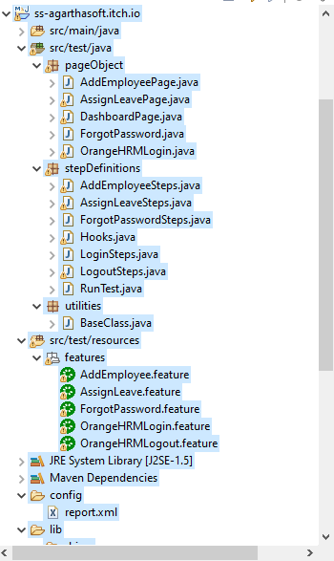
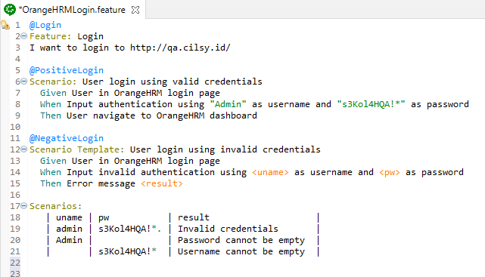
Cucumber

Slide 8
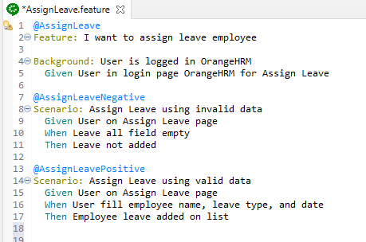
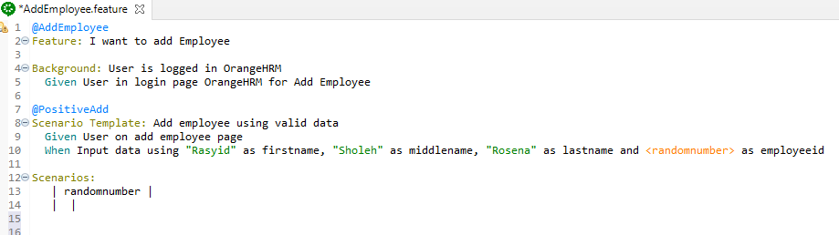
Cucumber

Slide 9
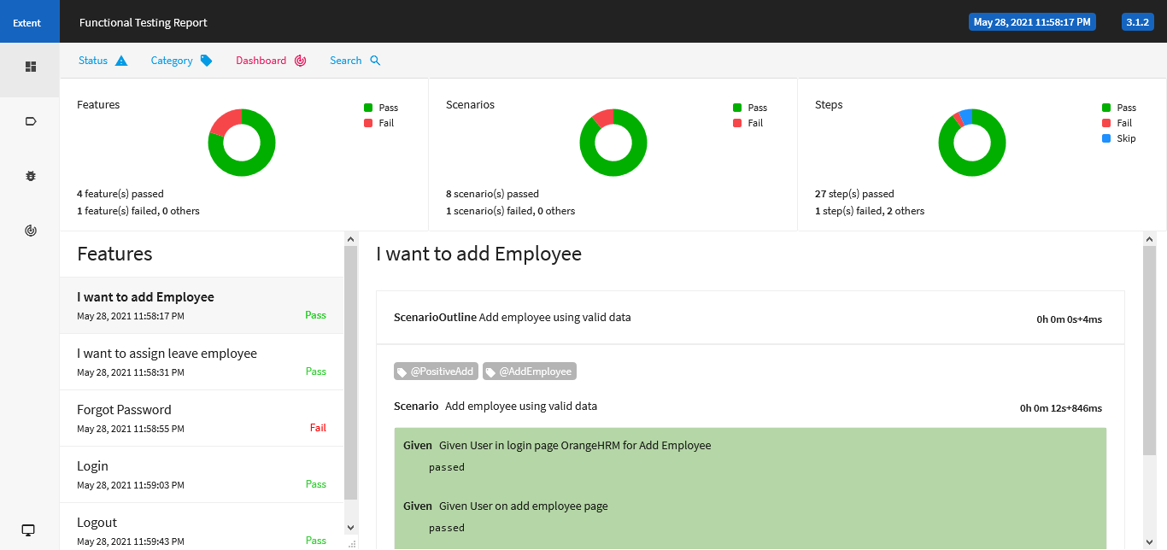
Cucumber

Slide 10
Ch 3
Chapter 3
JMeter Performance

Slide 11
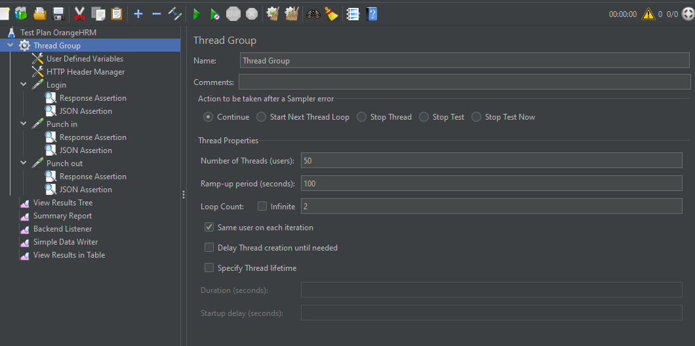
JMeter Performance

Slide 12
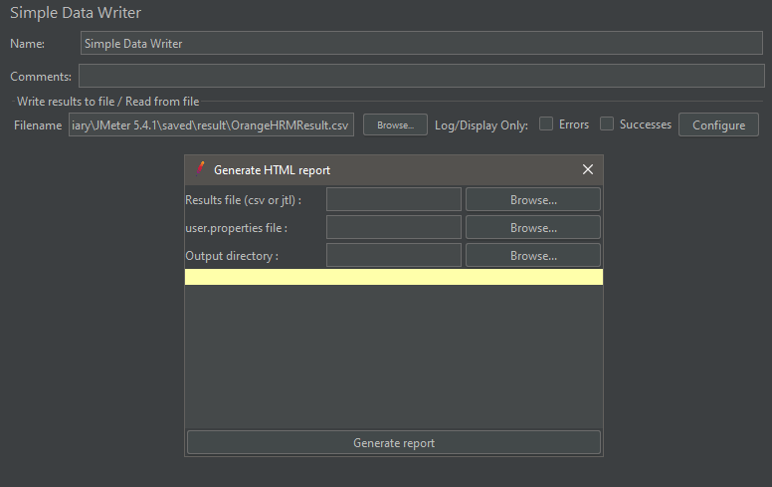
JMeter Performance

Slide 13
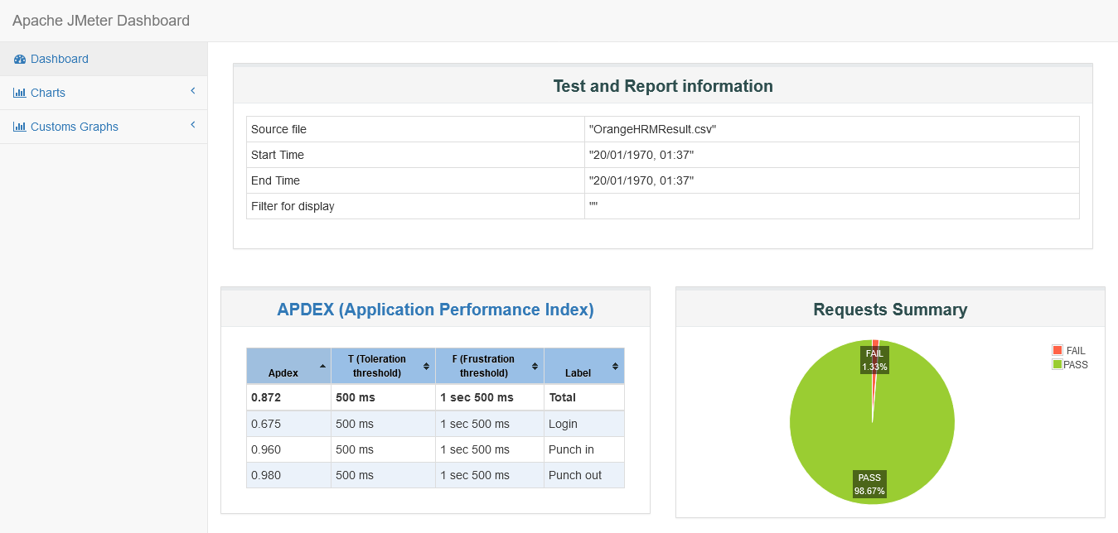
JMeter Performance

Slide 14
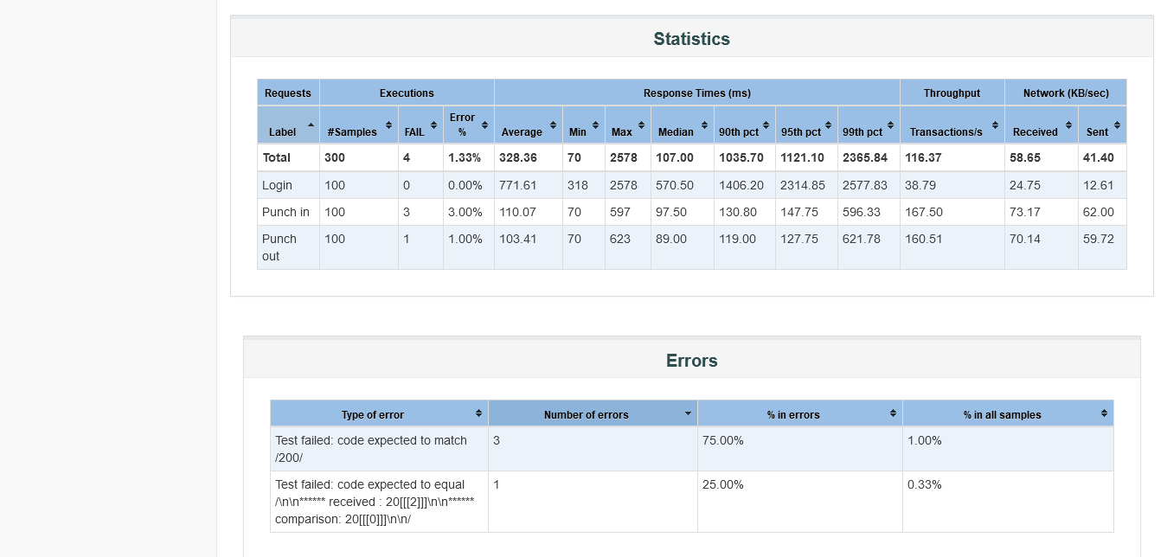
JMeter Performance

Slide 15
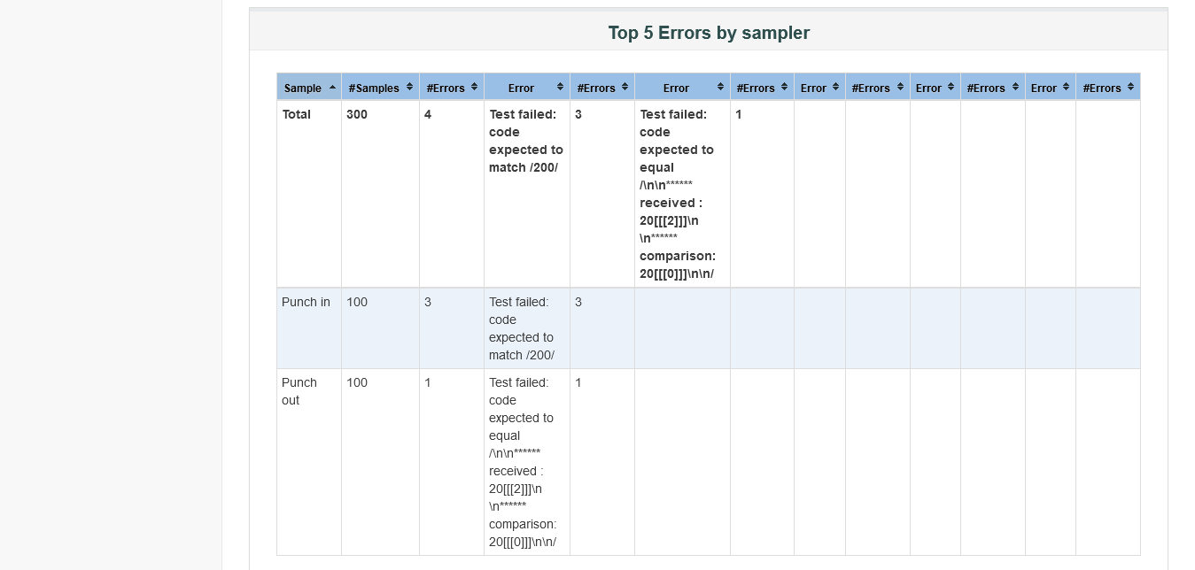
JMeter Performance

Slide 16
Ch 4
Chapter 4
API

Slide 17
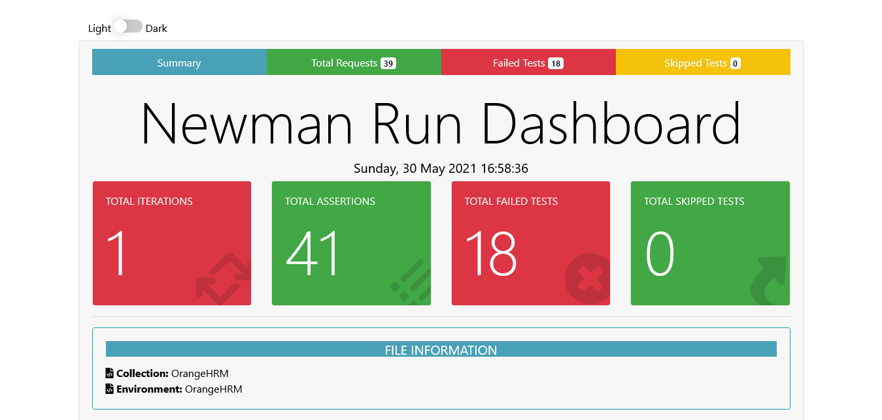
API

Slide 18
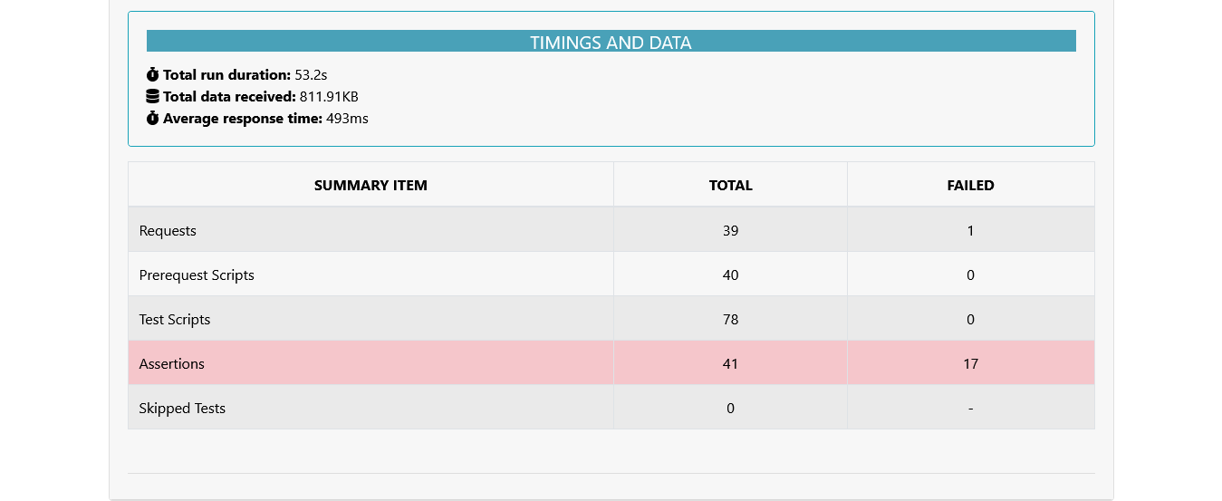
API

Slide 19
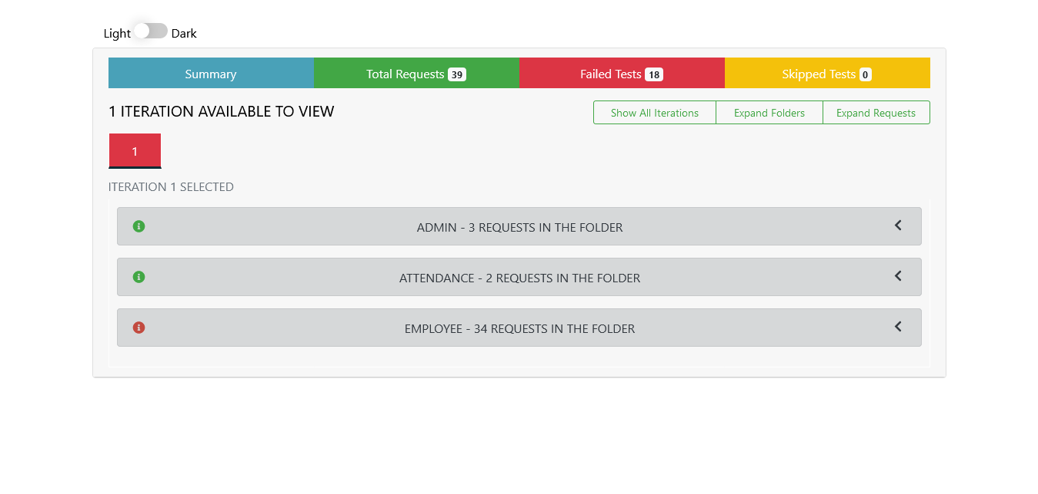
API

Slide 20
Ch 5
Chapter 5
Report Email

Slide 21
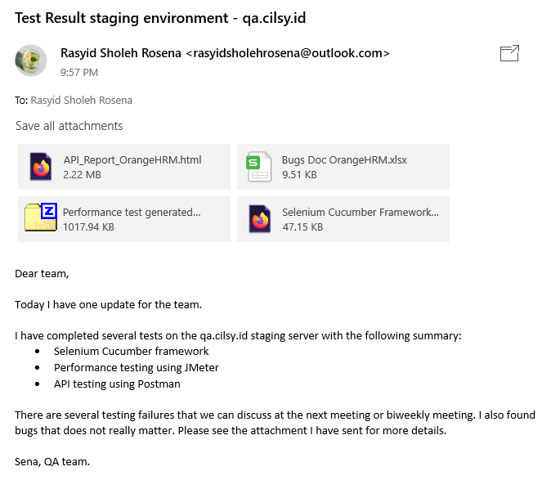
Report Email

Slide 22
Ch 6
Chapter 6
List Bugs

Slide 23
List Bugs
Bug ID | Bug Name | Step to Reproduce | Expected Result | Actual Result | Solution to Problem
B_001 | I could not back to dashboard page | I clicked back button on browser after login success | Navigate to url | Navigate to login page and if trying to click login button, warning show "Csrf token validation failed" | Clear cookies and site data, then reopen site/browser
Reported by: | Rasyid Sholeh Rosena
Source url: | http://qa.cilsy.id/symfony/web/index.php/dashboard

Slide 24
End slide
keep in touch
LinkedIn https://www.linkedin.com/in/rasyid-sholeh-rosena/
itch.io
https://ss-agarthasoft.itch.io/
GitHub
https://github.com/stevie8sena

